Slide 1
Exploratory Data Analysis of Retail Dataset
Name: Ravalika
Organization: NextHikes IT Solutions

Slide 2
Project Objectives
Univariate, Bivariate & Multivariate Analysis
Outlier Detection
Correlation Analysis
Skewness & Kurtosis

Slide 3
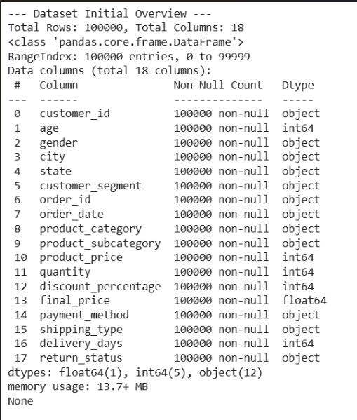
Dataset Overview
100,000 records
18 columns
Numerical, categorical and
date features

Slide 4
Methodology
Data loading
Summary statistics
Histograms & bar charts
Boxplots
Correlation heatmap
Scatter plots

Slide 5
📂 Dataset
EDA Process
🧹 Data Cleaning
📈 Visualization
📊 Statistical Analysis
🔍 Pattern Identification
💡 Business Insights

Slide 6
Key Findings
Relationship between product price and final price
Premium customers spend more
Outliers indicate high-value purchases
Discounts affect final price

Slide 7
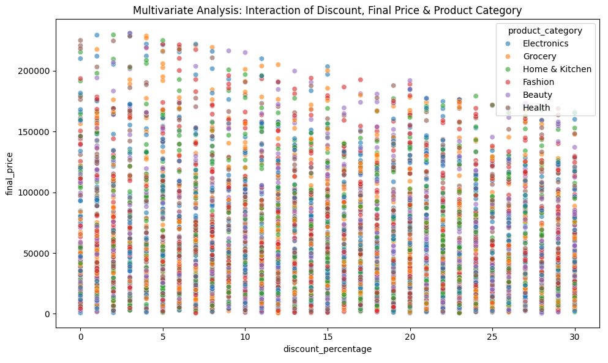
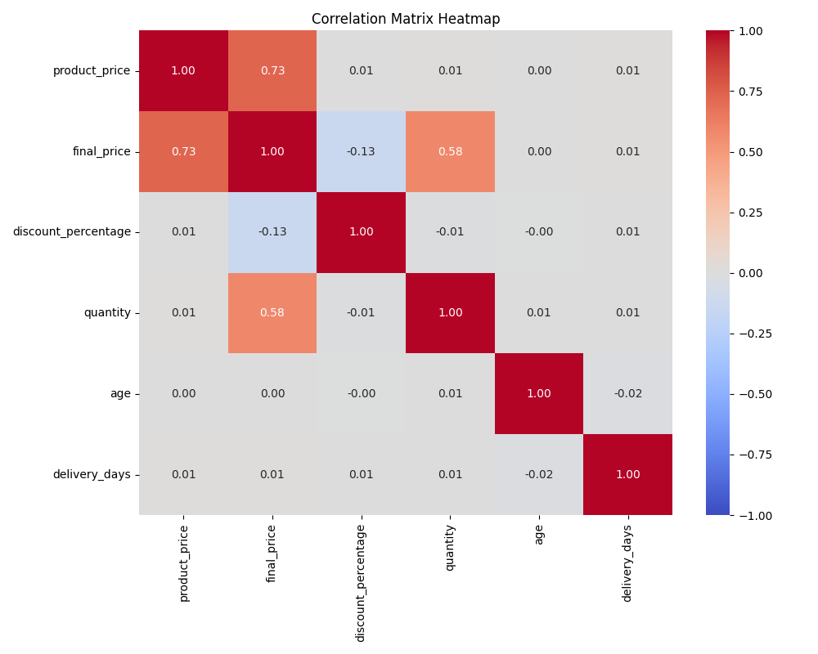
Key Findings
CORRELATION MATRIX HEATMAP
MULTIVARIATE ANALYSIS(SCATTER PLOT)
The multivariate scatter plot reveals relationships between product price, discounts, and final price, supporting better pricing and sales decisions.
The heatmap shows strong positive correlation between Product Price and Final Price.

Slide 8
BUSINESS INSIGHTS
👥 Customer Behaviour:
Different customer segments have different purchasing patterns.
💰 Pricing Strategy :
Product price and discounts influence the final selling price.
📦 Sales Performance :
Premium products contribute to higher revenue and sales.
📊 Decision Making:
EDA helps businesses improve pricing, marketing, and inventory decisions.

Slide 9






Tools & Libraries
Python Pandas NumPy
Matplotlib Seaborn SciPy

Slide 10
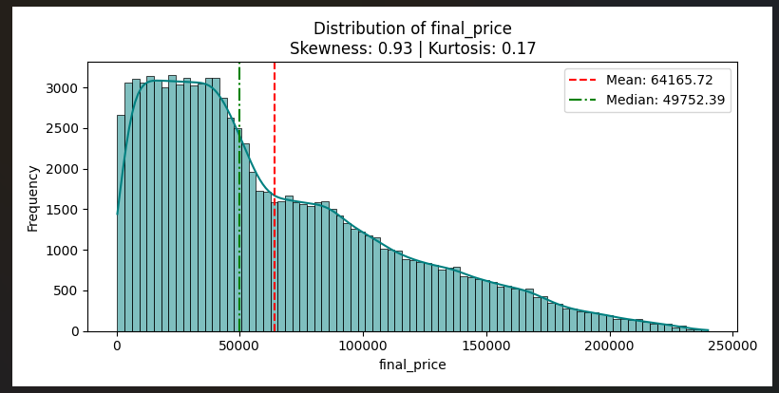
Project Summary
UNIVARIATE_NUM_FINAL_PRICE
Completed Univariate, Bivariate & Multivariate Analysis
Detected outliers using IQR
Measured Pearson correlation
Generated business insights
Shows the distribution of the final price.

Slide 11
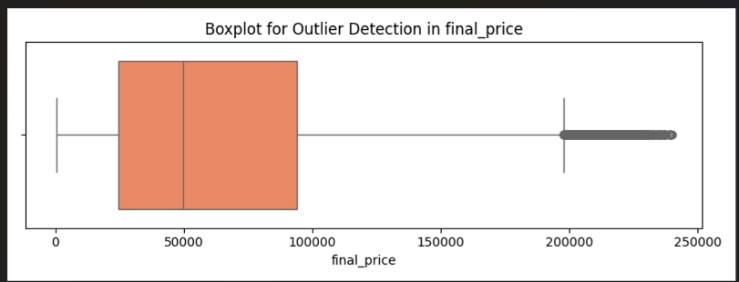
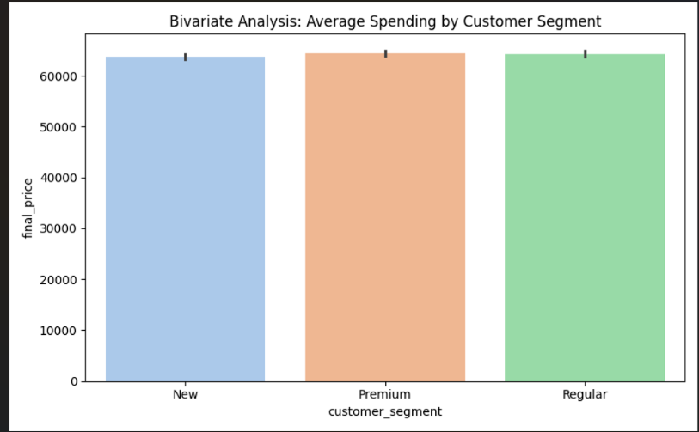
OUTLIERS_FINAL_PRICE
Highlights outliers using the IQR method.
BIVARIATE_SEGMENT_VS_SPENDING
Shows the average spending by customer segment.

Slide 12
THANK YOU

